Slide 1
Deep Reinforcement learning
For The use of learning new games with zero domain knowledge.

Slide 2
This presentation is adapted from a talk I gave on Deep Reinforcement Learning.
https://youtu.be/lLS4JxnB3c8?t=245
Feel Free to watch it :D
This presentation is on the use of DRL to learn to play board games from scratch.

Slide 3
What IS Reinforcement Learning?
Reinforcement Learning is an Agent with a Goal Interacting with an Environment and Learning from an Experience.
An Agent is a network with two functions: a value-function and a policy function.
A Goal is what you or the agent decides it wants to do. It is shaped by rewards.
Interacting means the agent taking Actions in the environment.
The Environment is the world in which the agent lives and is able to interact with.
Learning is the agent evaluating the rewards it earned and optimizing its value and policy functions to better achieve its goal.
Experience is everything the agent has done and seen. Its memory.

Slide 4
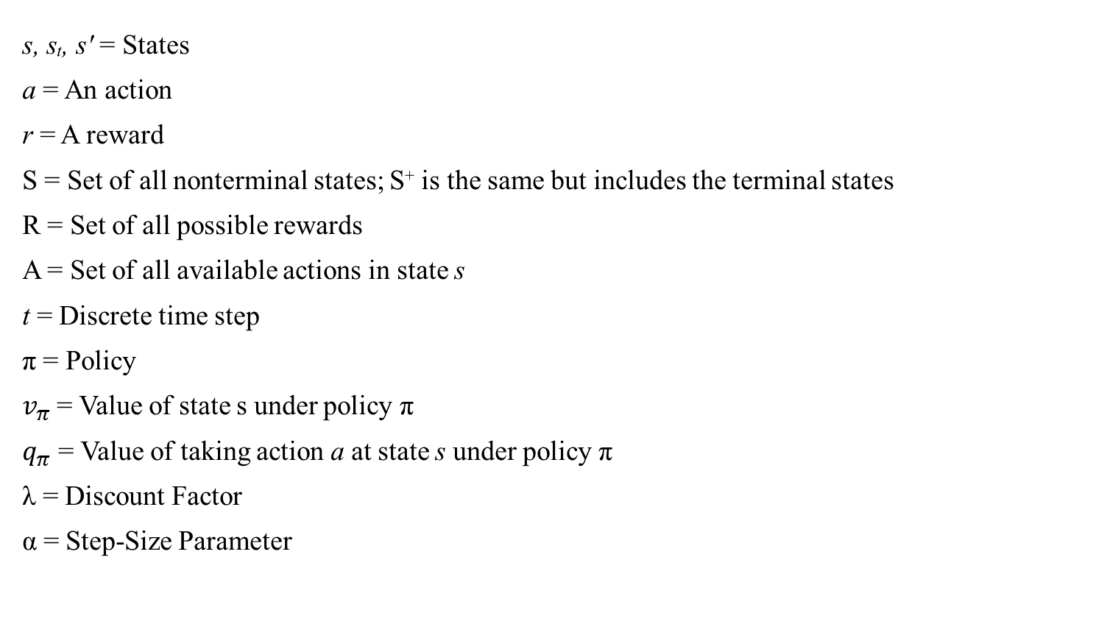
notation
s, sₜ, s′ = States
a = An action
r = A reward
S = Set of all nonterminal states; S⁺ is the same but includes the terminal states
R = Set of all possible rewards
A = Set of all available actions in state s
t = Discrete time step
π = Policy
$v_{π}$ = Value of state s under policy π
$q_{π}$ = Value of taking action a at state s under policy π
λ = Discount Factor
α = Step-Size Parameter

Slide 5
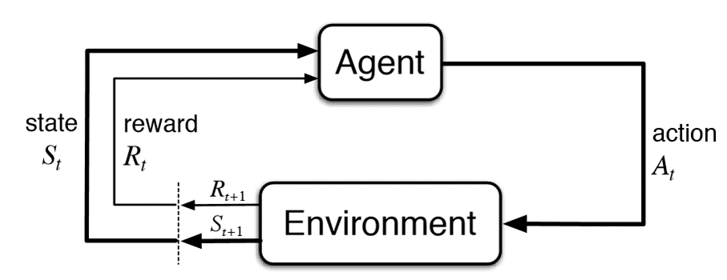
Markov Decision Process
The Markov Decision Process, MDP, is the core of RL.
The Environment is set up and the agent looks at it in time steps as States. The agent then preforms an action in order to get closer to its goal. That action affects the Environment and changes it creating a new State, sₜ₊₁.
The reward signal is then updated and the agent learns from its behaviour. (Trail and Error)
Our agent seeks to increase Value NOT Rewards.

Slide 6
What is the agent and what isn’t?
An Agent-Environment boundary line defines what the agent is. In a robot or animal what is the agent and what is the environment? The agent would be the ‘brain’ and the body and world the environment.
What makes up an agent?
The value function:
Gives the model a sense of long term and short term goals and rewards.
What the agents seeks to improve.
The policy function:
Determines what actions the agent takes.
What are NN seek to improve.

Slide 7
How can we give the agent a goal?
We can imply our desires to the agent through positive and negative rewards. This is the Reinforce part of RL.
Ways to accomplish this:
Giving constant rewards per time step.
Giving conditional rewards per action.
Giving large rewards on completion of goal.
Be careful not to give a large reward to sub-
goals or your agent might overfit to something
stupid. Like this → → →

Slide 8
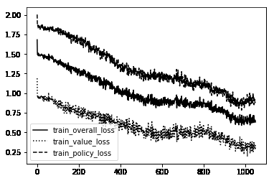
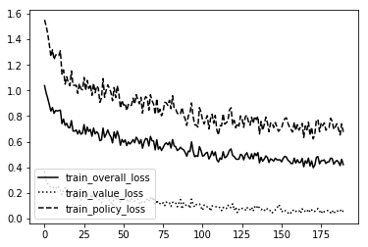
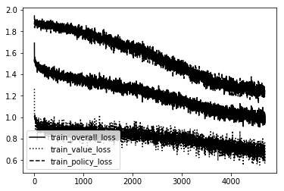
Good hyperparameters

Slide 9
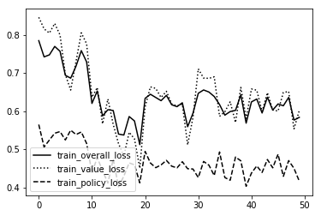
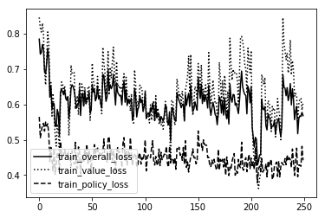
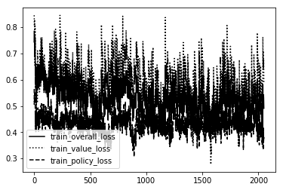
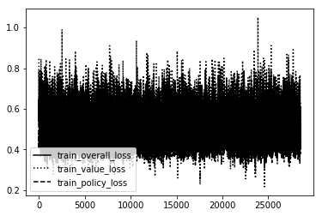
bad hyperparameters

Slide 10
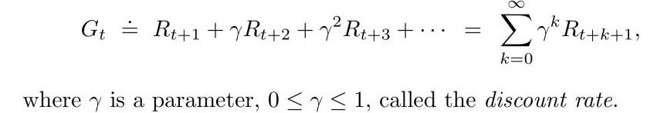
How does it learn?
The agent learns in two ways:
It can optimize the policy based off of the difference in expected reward and true reward.
A NN can learn to map the Q-values and adjust weights along gradients and other methods to reduce error.
We use a discount parameter, to make the agent hedonistic.
This allows the agent to achieve more during life and not focus on death.
A λ of 0 makes it only focused on the immediate reward.
A λ of 1 makes it consider all rewards equally.

Slide 11
Three main themes of rl
Every new model of RL seeks to improve three areas:
Exploration/ Exploitation(Greedy).
The way the agent creates goals and how it learns from it.
The computation speed until convergence and the accuracy of results.
Exploration vs Greed
Greedy: The agent only considers the immediate best reward
Epsilon Greedy: The agent considers the best reward most of the time and a random reward ε times
Stationary epsilon: The value never changes. Usually .1 - .3 range with .2 being a goto.
Epsilon Decay: The value starts high then decays per time step to a min number. .99 to .1
Optimistic: Set a very high starting value or bias which makes the agent only go after rewards higher then the starting bias.
Upper Confidence Bounds: A policy selects actions repeatedly until it understands the potential and optimal paths better. Actions with lower value estimates or that have been selected often will be picked less frequently over time.

Slide 12
Our model
Our model:
Uses a Residual Neural Network that has Convolutional Layers to it that help classify the game states.
Uses a Epsilon Greedy model that has the first 10 games 100% epsilon and the rest of the games at 20% epsilon. This fills the memory of the model quickly and makes it more creative in the future.
Uses each turn of the game as the states in which it takes action on. The agent is only rewarded at the end of each game with a win = +2, a loss = -1, and a draw = -.1 to incentivise the agent to win as much as possible and to avoid drawing. This makes our agents never happy unless they are crushing their opponents and will inspire creativity in their actions to try to win.
Uses a Monte Carlo Tree Search along with its policy head to make decisions on what action to take. They both make predictions on the value of each action and are both updated based on which one was closer to the actual value of the action.
Uses no prior knowledge of the game. It only knows the rules and what actions are available to it at any given state. Everything else is learned behaviour and knowledge.

Slide 13
Results of training
Our agent trained on: Tic Tac Toe, Connect 4 and MetaSquares. Using a GTX 1080 Graphics Card
On the Tic Tac Toe game the agent was trained in 4 hours and had already ‘perfected’ the game. The players would always tie which is the solved state of Tic Tac Toe. They only took about 2 hours to get above ‘human’ level play. But considering that ‘human level’ in this sense is around a middle schooler that’s not that great of a feat.
On the Connect 4 game the agent was trained in 16 hours. It perfected the game in around 26 hours. It was already above human level play at the 16 hour mark but had not solved the game until much later. The solved state of connect 4 is player 1 wins every time. This is a good sign though as we could use this technology to solve every type of game including real world ‘games’ such as driving, flying, cooking etc.
On the MetaSquares game the agent took over 36 hours to train and it was barely above human level! I can’t imagine how long it would take to solve the game as I gave up early on training it. Maybe we aren’t close enough to solve driving with this unless you use something stronger then a single GTX 1080!

Slide 14
Results of testing
We created several versions of each model to compare how scale and Q-depth effected learning speed and strength.
The low Q-depth Models did not even learn how to play the games most of the time and got stuck in a local maxima of winning after the minimum number of moves and deciding the winner based off of how many times each player went first! So we see that the size of the brain being used is VERY important!
The large scale and high Q-depth models beat our standard benchmarks very convincingly but at the same time they took almost twice as long to train to reach the same point. This might not be an issue for large corporations like google but for us independent researchers this was a nightmare.
The overall value of increasing Q-depth, Memory, Epochs and Scale can not be overstated though! If you want to make a better model you just increase these things. Easy.
When comparing the models on new games the agents from the less complex games could not do anything on the more complex games. The weights and knowledge from learning just did not transfer well enough. We might be able to come up with a better transfer learning solution in the future and I hope so!

Slide 15
Final Thoughts
I started this project because of Alpha Zero and the amazing work from Google’s DeepMind. They inspired me to try and do it myself and it worked! The future of AI and game development will forever be changed because of this technology and all the great creators working on projects like this one. I hope to be a cog in the wheel of innovation as we create the future!
Deep Reinforcement Learning will continue growing and evolving to the point that every problem in life will be solved with it in some way. I am confident that RL and bootstrapped models will pave a way for new technology that will dwarf what we currently have available to us in the soon to be future. Models that can learn by themselves any task will become real and available to us to help us with every task we have. I can’t wait to live in that future and hopefully I will help build it.

Slide 16


THANK YOU
Chris Harvey
931 220 2250
chris.harvey0248@yahoo.com

Slide 17
Additional learning
“Steps toward Artificial Intelligence” - Minsky
“Reinforcement Learning: An Introduction 2nd Edition” - Sutton and Barto
https://skymind.ai/wiki/deep-reinforcement-learning
‘Hindsight Experience Replay’ – OpenAI, Andrychowicz
‘Deep Reinforcement Learning: Pong from Pixels’ - Karpathy
http://www0.cs.ucl.ac.uk/staff/d.silver/web/Teaching.html
https://lilianweng.github.io/lil-log/2018/04/08/policy-gradient-algorithms.html
https://robotacademy.net.au
https://towardsdatascience.com/proximal-policy-optimization-ppo-with-sonic-the-hedgehog-2-and-3-c9c21dbed5e
https://towardsdatascience.com/curiosity-driven-learning-made-easy-part-i-d3e5a2263359

